Slide 1
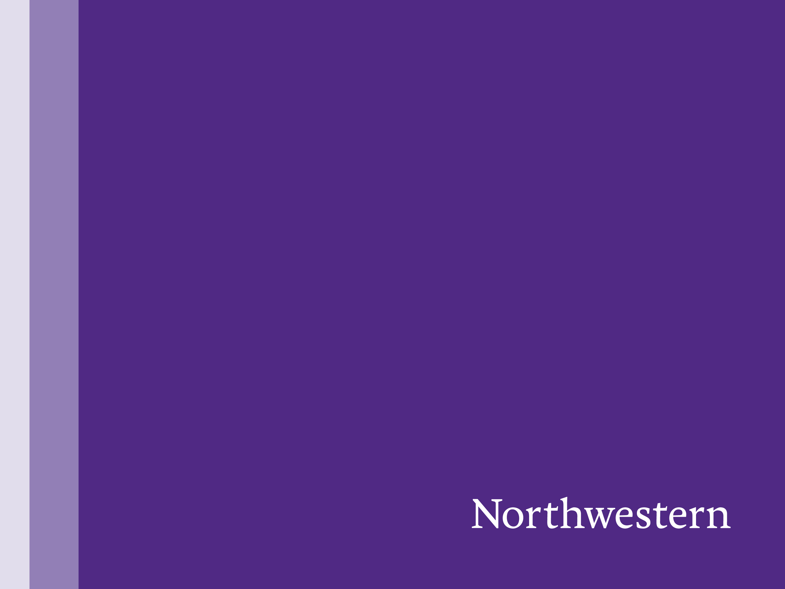
Event-camera aided Video Frame Interpolation
CS 396 Natural and Artificial Vision
Daizong Tian

Slide 2
1. What is an event camera 2. Intro to Super-resolution 3. Temporal Super resolution 3.1. What is it 3.2. How event camera can help 4. Future Expectation
Notes:
Today I am goint

Slide 3
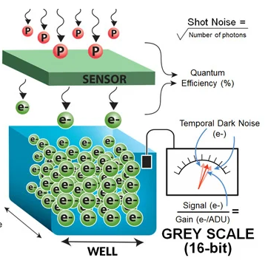
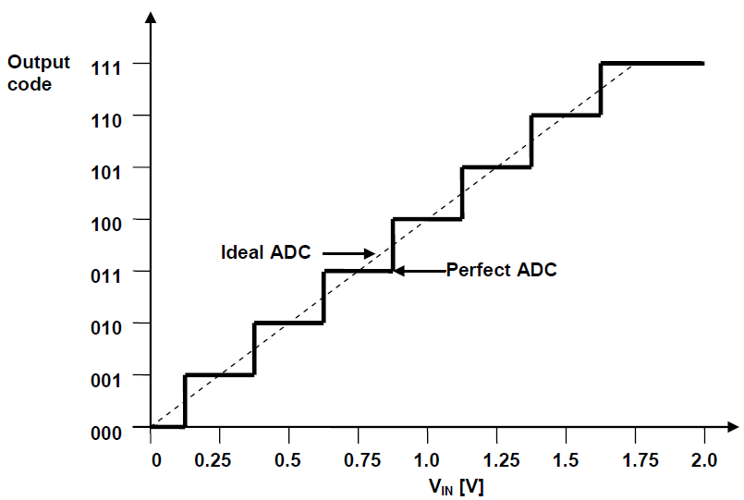
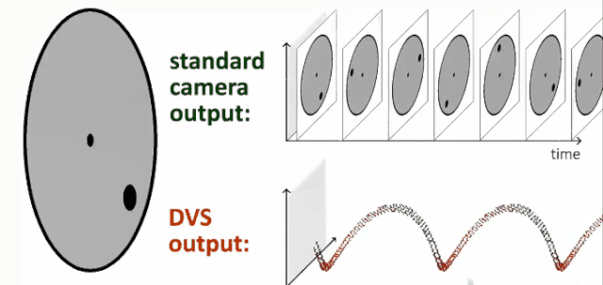
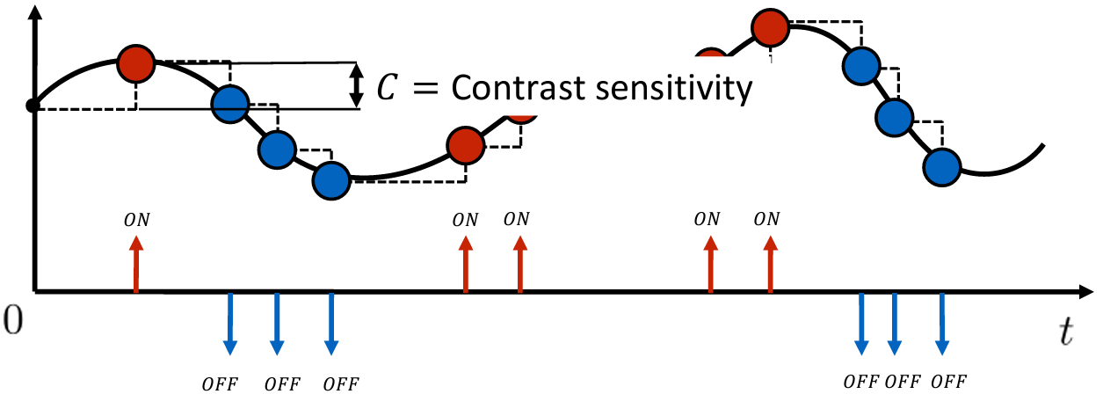
1. What is an event camera (sensor)
Conventional capture light intensity in a time period
(FLIR Systems)
(Microchip.com)
(Nabil Madali)
(Scaramuzza, UZH)
Event camera captures intensity changes, not the actual intensity
If nothing changes in the scene:
Conventional still capture the still image
Event camera will have no outputs

Slide 4
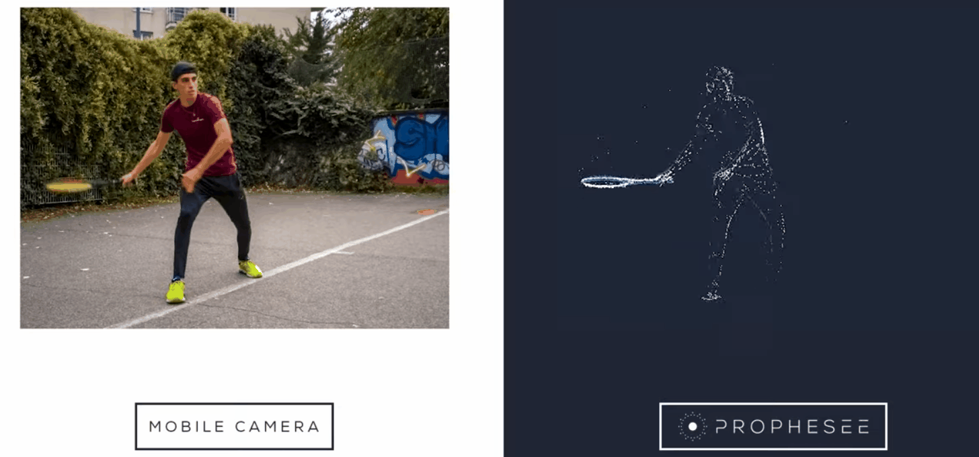
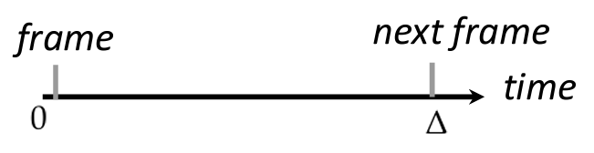
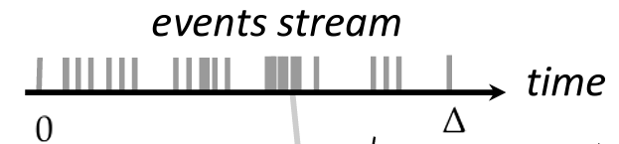
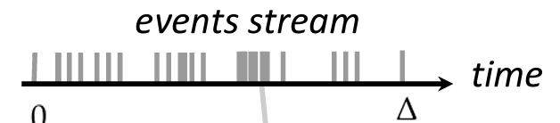
1. What is an event camera (sensor)
Everything, but slowly
Only motion, but fast
(prophesee, 2023)
(Scaramuzza, UZH)
Conventional camera captures total light within certain amount of time
Event camera captures time when certain amount of light changes
If no light change (static), event camera cannot sense it.

Slide 5
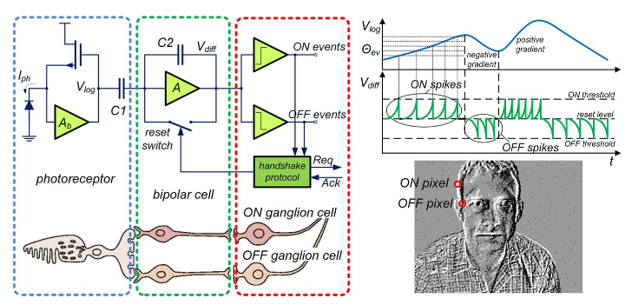
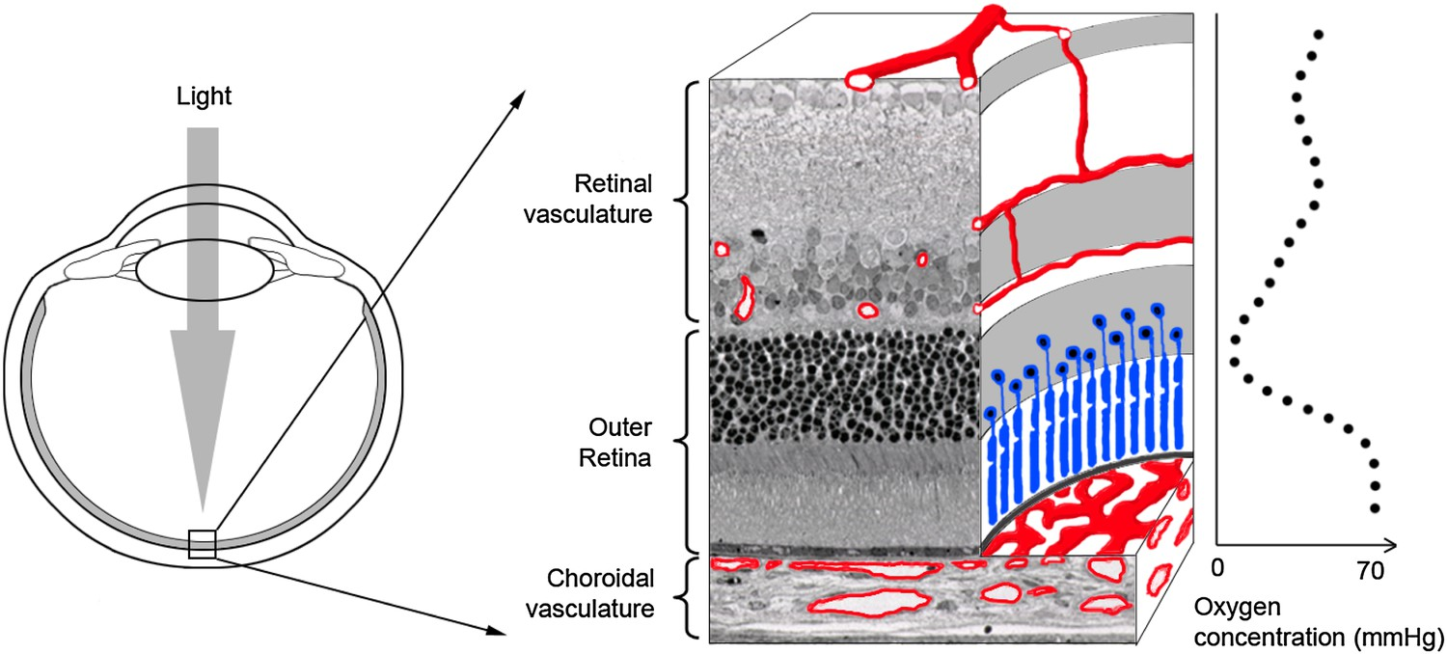
1. What is an event camera – bio-inspired
Event cameras are bio-inspired!
Event cameras mimic some part of human vision system.
(Posch, 2014)
Retinas are sensitive to intensity changes.
You cannot see the blood vessel before your retina!
(Wangsa-Wirawan, 2003)

Slide 6
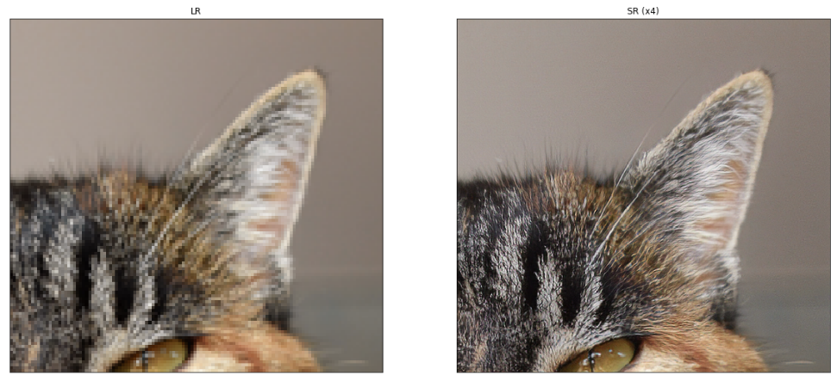
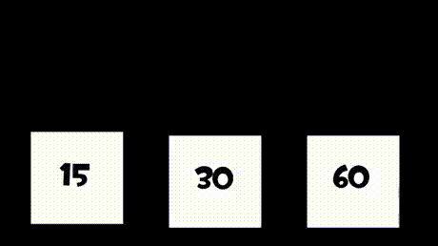
2. Super-resolution
Spatial Super-Resolution: Enhance the quality of single image spatially
Temporal Super-Resolution: Enhance the smoothness of image sequence temporally
Both may take advantage of motion estimation and compensation
(Martin Krasser)
(lordsofgaming.net)
blur
sharp
jaggy
smooth
Spatial: Image clearer/shaper
Temporal: Video smoother

Slide 7
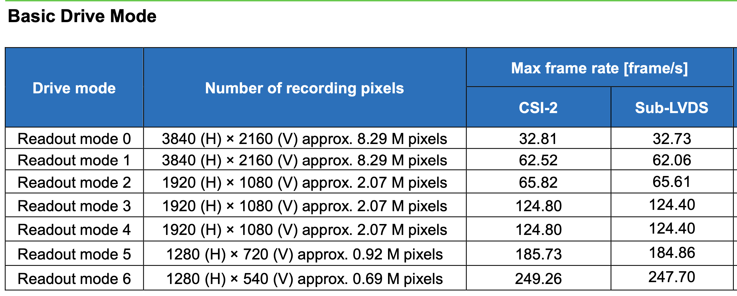
2. Why we need VFI?
Real-world video recording limitations: Sensor read-out bandwidth
Sony IMX317CQC datasheet
Question: Do you want a higher resolution or a higher framerate?

Slide 8
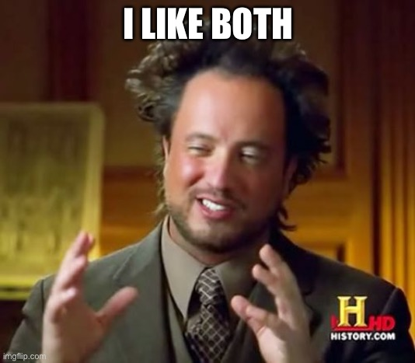
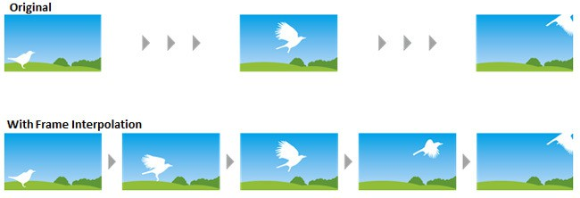
2. Why we need VFI?
Question: Do you want a high resolution or a high framerate?
Then Video frame interpolation could help you
(displayninja.com)

Slide 9
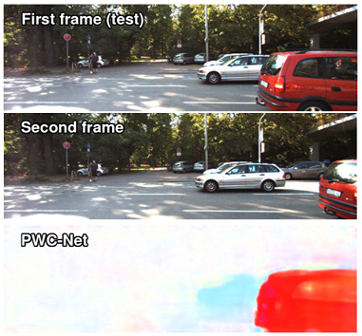
2.1 Conventional camera VFI SOTA methods
Milestones for state-of-the-art NN conventional camera
video interpolation：
Splatting-based Synthesis for Video Frame Interpolation
(Adobe, PKU, 2023)
Enhanced Quadratic Video Interpolation
(UCAS, SenseTime, 2020)
Frame Interpolation for Large Motion
(Google, UW, 2022)
Quadratic Video Interpolation
(CMU, SenseTime, 2019)
SepConv
(PSU, 2017)
Super SloMo
(UMass, Nvidia, 2017)
First successful flow-based VFI algorithm
Winner of AIM2019 VTSR
Very good performance, decent runtime
Winner of AIM2020 VTSR
Best performance even in 2022,
slow runtime
Targeted for large motion
Forward Warping
Mostly Optical-Flow based!
Like disparity map
Optical flow from pwc-net (Sun, 2017)

Slide 10
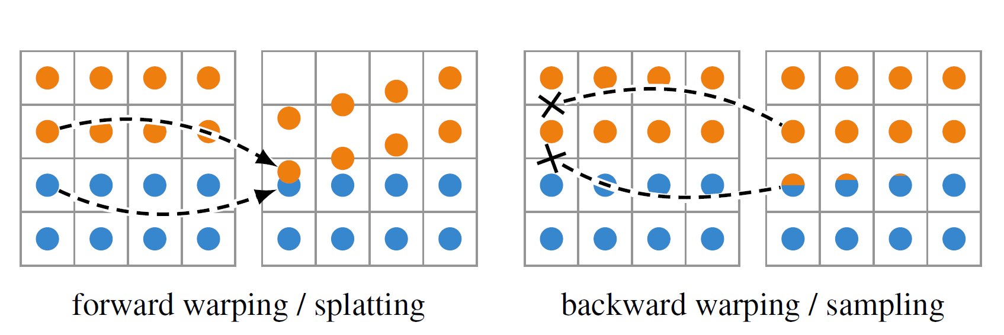

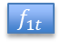




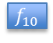

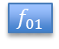
How Optical-flow- based VFI works?
Warping
$i_{0t}$
Frame 0
$i_{0}$
Optical Flow net
$f_{01}$
Flow Interpolation
$f_{0t}$
Interpolation net
$i_{t}$
Frame 1
$i_{1}$
Optical Flow net
$f_{10}$
Flow Interpolation
$f_{1t}$
Interpolated Frame
Warping
$i_{1t}$
Motion Estimation
Interpolation
Task ：
Motion Estimation: Get optical flows
FlowNet, pwc-net, ScopeFlow, RAFT, etc.
Interpolation
Image warping
Combine pixels from two frames
Backward Warping:
Interpolated frame
Forward Warping:
Interpolated frame
Optical flow from pwc-net (Sun, 2017)

Slide 11
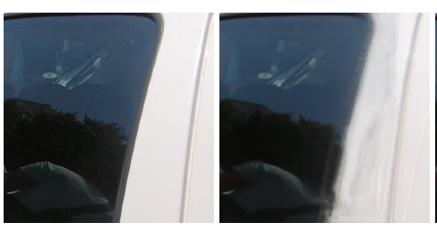
Main problems for conventional camera optical-flow based VFI
Inaccurate background
GT VFI
(Xu, 2019)
Reasons:
A lot of different objects share same pixel value
Possible motion range is large
Optical flow estimated from frames are not accurate, especially for smooth area
Optical flow from pwc-net (Sun, 2017)

Slide 12
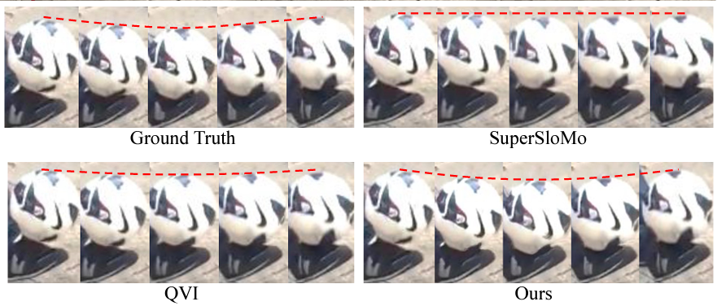
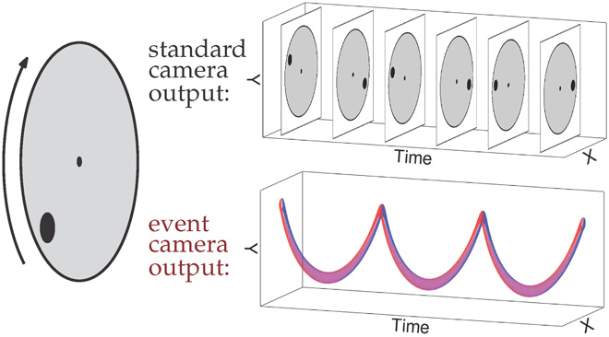
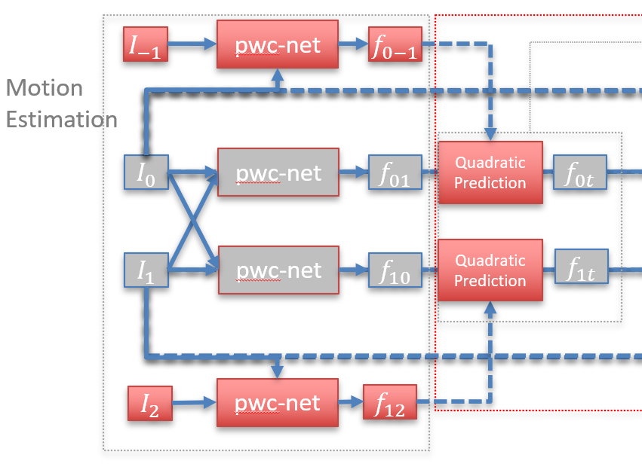
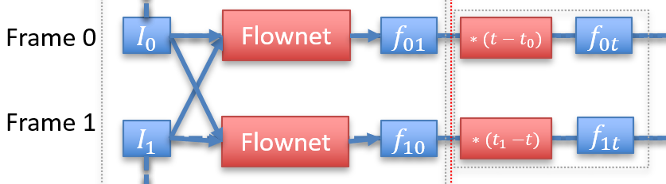
Main problems for conventional camera optical-flow based VFI
Inaccurate motion
(He, 2022)
QVI
Super Slomo
Need to make assumption on motion, to get intermediate optical flow

Slide 13
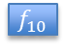

Main problems for optical-flow based VFI
Conventional optical flow estimation:
Event camera can help!
Conventional camera:
Guessing motions from two frames
Flownet
$f_{01}$
Flownet
$f_{10}$
Event camera:
Records the whole process of the motion, and only the motion
(David, 2020)
Event camera: 1. Provide motion information
2. Does not bring redundant info

Slide 14
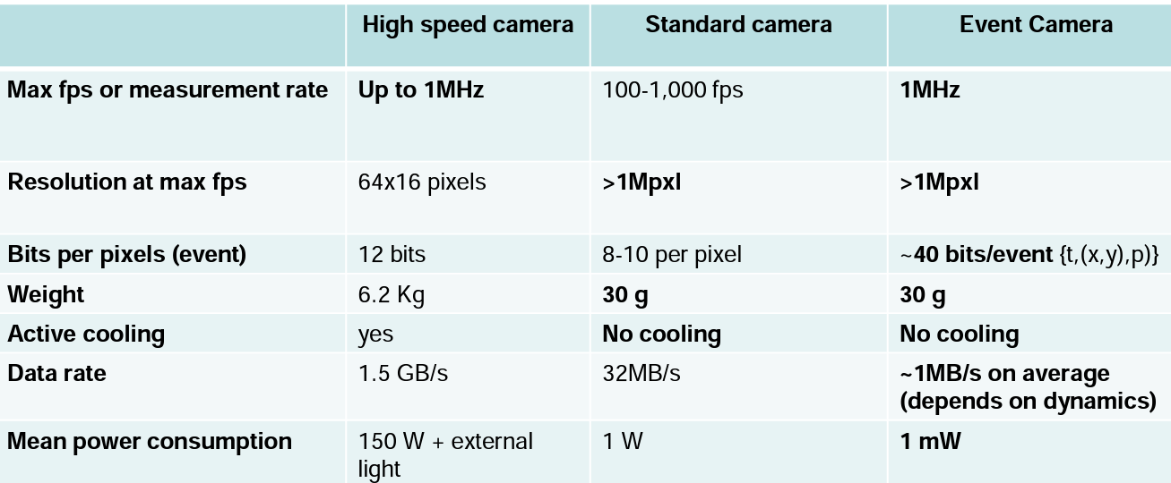
Main problems for optical-flow based VFI
Conventional optical flow estimation:
(Scaramuzza, UZH)
Event camera: 1. Provide more motion information
2. Does not bring redundant info
3. Consumes little energy

Slide 15
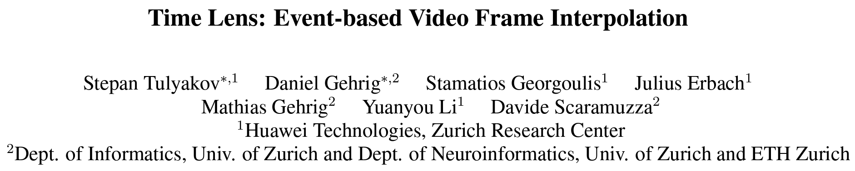
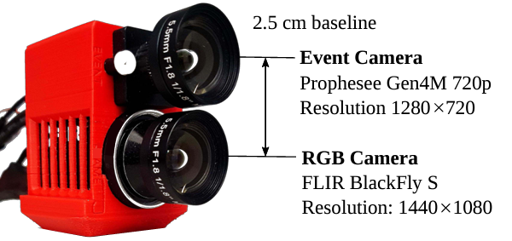
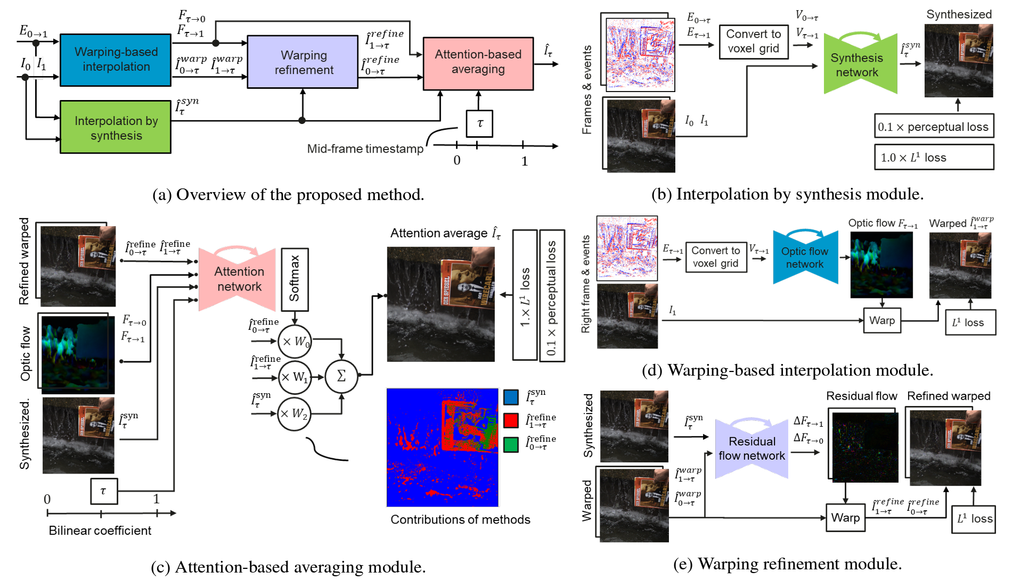
How can event-camera help?
CVPR 2021
Event-camera based frame synthesis (Additional Information)
+
Event camera generated optical flow (Better optical flow estimation)

Slide 16
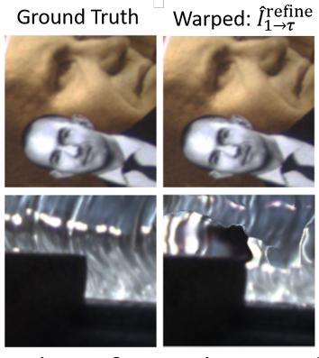
How can event-camera help?
CVPR 2021
More accurate optical flow than conventional camera method
Pros:
dense pixel correspondence, controlled warping, high quality.
Cons:
cannot handle illumination change, occlusions , object shape changes, etc…

Slide 17
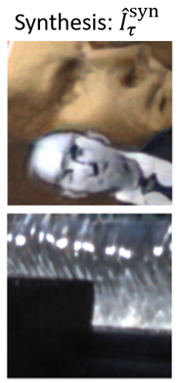
How can event-camera help?
CVPR 2021
Handel illumination change
Pros:
Does not have any assumption. Can handle illumination change, occluded objects ,object re-shaping
Cons:
non-constrained network may produce undesired artifacts.

Slide 18
How can event-camera help?
CVPR 2021
Use synthesized result to refine warping.
Improve warping-based interpolation.
Inpainting occluded area with nearby regions

Slide 19
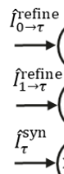
How can event-camera help?
CVPR 2021
Put everything together!
Good quality but no illumining change
Warp from frame 0
Warp from frame 1
Additional info but not perfect quality
Synthesized frame
Event-camera based frame synthesis (Additional Information)
+
Event camera generated optical flow (Better optical flow estimation)

Slide 20
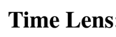
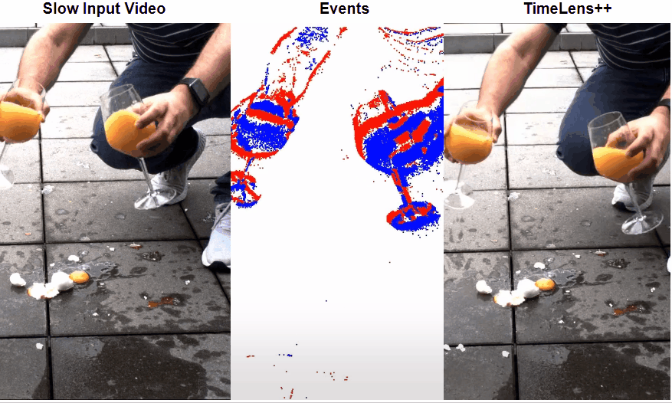
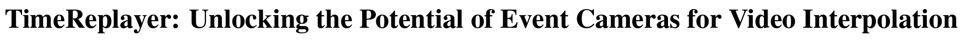
How can event-camera help?
Amazing smoothness of liquids
CVPR 2022
Better motion recover than
Conventional-camera-based methods

Slide 21

Future expectation
Low power consumption: Smartphones

Slide 22
Thank you!

Slide 23
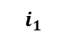
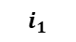
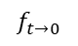
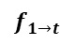
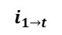
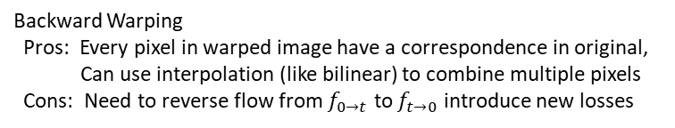
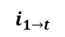
How Optical-flow- based VFI works?
Warping
$i_{0t}$
Frame 0
$i_{0}$
Optical Flow net
$f_{01}$
Flow Interpolation
$f_{0t}$
Interpolation net
$i_{t}$
Frame 1
$i_{1}$
Optical Flow net
$f_{10}$
Flow Interpolation
$f_{1t}$
Interpolated Frame
Warping
$i_{1t}$
Motion Estimation
Interpolation
Task ：
Motion Estimation: Get bi-direction optical flows
Modern optical flow estimation (NN-based): FlowNet, pwc-net, ScopeFlow, RAFT, etc.
Interpolation
Image warping
Combine pixels from two
Warping
$$i_{1}$$
$$i_{1→t}$$
$$i_{1}$$
$$i_{1→t}$$
$$f_{1→t}$$
$$f_{t→0}$$
Optical flow from pwc-net (Sun, 2017)
Forward Warping
Pros: Straight forward
Cons: Multiple pixel falls in one pixel
Holes on warped image (No pixel falls in)
Backward Warping
Pros: Every pixel in warped image have a correspondence in original,
Can use interpolation (like bilinear) to combine multiple pixels
Cons: Need to reverse flow from $f_{0→t}$ to $f_{t→0}$ introduce new losses

Slide 24
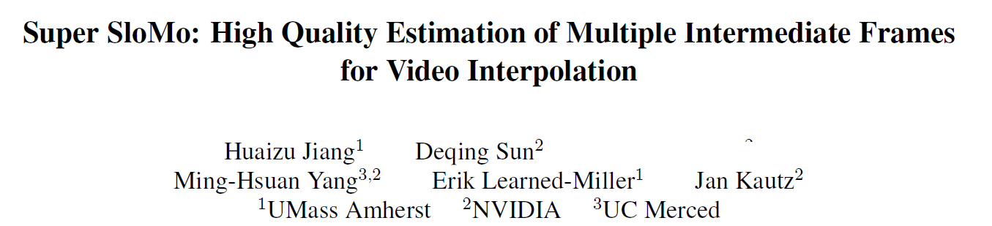
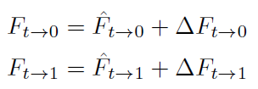
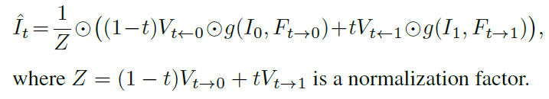
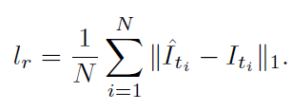
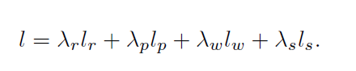

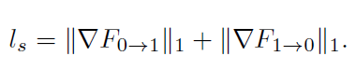

























The Baseline:
Backward Warping, needs flow reversal,
reverse flow from $f_{0→t}$ to $f_{t→0}$: simply take negative. Simple, fast but inaccurate
Compensate inaccurate flow
Back Warp
$i_{t0}$
Frame 0
$I_{0}$
Flownet
$f_{01}$
${∗(t−t}_{0})$
$f_{0t}$
$$∗−1$$
$f_{t0}$
+
${∆f}_{t0}$
$F_{t0}$
UNet
$V_{t0,t1}$
Fusion
$I_{t}$
Frame 1
$I_{1}$
Flownet
$f_{10}$
${∗(t}_{1}−t)$
$f_{1t}$
$$∗−1$$
$f_{t1}$
${∆f}_{t1}$
Interpolated Frame
+
$F_{t1}$
Back Warp
$i_{t1}$
Motion Estimation
Loss and regulations:
Reconstruction Loss: Distance between Interpolated frame and ground truth
Smoothness Loss: Total variation of optical flow $F_{t}$. Regulate flow compensation ${∆f}_{t}$
To make flow does not change dramatically. Idea from DVF (2)
Perceptual Loss: Makes the image sharper.
Empirically chosen from middle of one UNET layer. Idea from SepConv (1)
Warp Loss: Distance between original frame and warping result $g\left(I_{0,1},f_{01,10}\right)$ , to regulate optical flow network;
Plus distance between interpolated frame and warping result $g\left(I_{0,1},f_{t0,t1}\right)$ , to regulate optical flow compensation;
SepConv (1): S. Niklaus, L. Mai, and F. Liu. Video frame interpolation via adaptive separable convolution. In ICCV, 2017.
DVF (2): Z. Liu, R. Yeh, X. Tang, Y. Liu, and A. Agarwala. Video frame synthesis using deep voxel flow. In ICCV, 2017.
Flownet: E. Ilg, N. Mayer, T. Saikia, M. Keuper, A. Dosovitskiy, and T. Brox. Flownet 2.0: Evolution of optical flow estimation with deep networks. In CVPR, 2017

Slide 25


























2019 AIM- VTSR Winner
Compensate errors from flow network and flow reversal
Flow reversal from $f_{0→t}$ to $f_{t→0}$ Neighborhood-averaging Forward Warping
$I_{−1}$
pwc-net
$f_{0−1}$
Assume Quadratic Motion
Motion Estimation
Back Warp
$i_{t0}$
Adaptive Filter
$F_{t0}$
$I_{0}$
pwc-net
$f_{01}$
Quadratic Prediction
$f_{0t}$
Flow Reversal
$f_{t0}$
Offset $u$
${∆f}_{t0}$
UNet
$V_{t0,t1}$
Fusion
$I_{t}$
$I_{1}$
pwc-net
$f_{10}$
Quadratic Prediction
$f_{1t}$
Flow Reversal
$f_{t1}$
Offset $u$
${∆f}_{t1}$
Interpolated Frame
Back Warp
$i_{t1}$
Adaptive Filter
$F_{t1}$
$I_{2}$
pwc-net
$f_{12}$
Interpolation

Slide 26
references
Falanga, Davide, Kevin Kleber, and Davide Scaramuzza. "Dynamic obstacle avoidance for quadrotors with event cameras." Science Robotics 5.40 (2020): eaaz9712.
https://en.wikipedia.org/wiki/Event_camera
Wangsa-Wirawan, Norbert D., and Robert A. Linsenmeier. "Retinal oxygen: fundamental and clinical aspects." Archives of ophthalmology 121.4 (2003): 547-557.
https://www.prophesee.ai/2023/02/27/prophesee-qualcomm-collaboration-snapdragon/
C. Posch, T. Serrano-Gotarredona, B. Linares-Barranco and T. Delbruck, "Retinomorphic Event-Based Vision Sensors: Bioinspired Cameras With Spiking Output," in Proceedings of the IEEE, vol. 102, no. 10, pp. 1470-1484, Oct. 2014, doi: 10.1109/JPROC.2014.2346153.
Sun, Deqing, et al. "Pwc-net: Cnns for optical flow using pyramid, warping, and cost volume." Proceedings of the IEEE conference on computer vision and pattern recognition. 2018.
Nah, Seungjun, et al. "AIM 2019 challenge on video temporal super-resolution: Methods and results." 2019 IEEE/CVF International Conference on Computer Vision Workshop (ICCVW). IEEE, 2019.
Jiang, Huaizu, et al. "Super slomo: High quality estimation of multiple intermediate frames for video interpolation." Proceedings of the IEEE conference on computer vision and pattern recognition. 2018.
Xu, Xiangyu, et al. "Quadratic video interpolation." Advances in Neural Information Processing Systems 32 (2019).
Tulyakov, Stepan, et al. "Time lens: Event-based video frame interpolation." Proceedings of the IEEE/CVF conference on computer vision and pattern recognition. 2021.
He, Weihua, et al. "TimeReplayer: Unlocking the potential of event cameras for video interpolation." Proceedings of the IEEE/CVF Conference on Computer Vision and Pattern Recognition. 2022.

